Slide 1
Network Vision Discussion Paper
Transmission Network Stakeholder Forum
Rainer Korte
Executive Manager Asset Management

Slide 2
Presentation Purpose
To begin a conversation about…
  What’s changing in the electricity industry
  What customers and consumers value
  The future role of the transmission network
  What are the proposed directions and priorities for the next five years?
Develop shared understanding

Slide 3
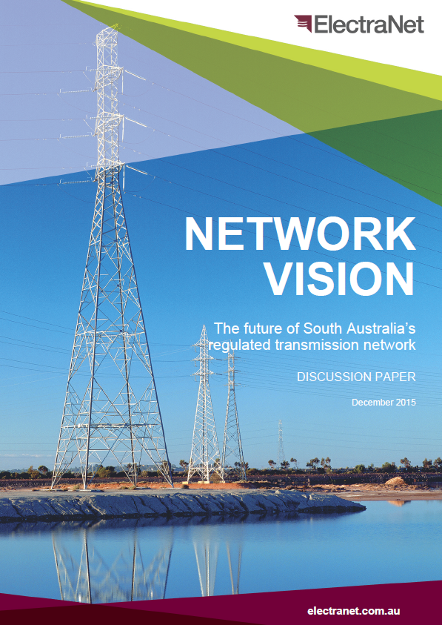
Network Vision Discussion Paper
Introduction
What do consumers value?
Role of the transmission network
Change drivers
Planning for the future
Future scenario implications
Network Vision
Directions and priorities
Feedback by 15 January 2016

Slide 4
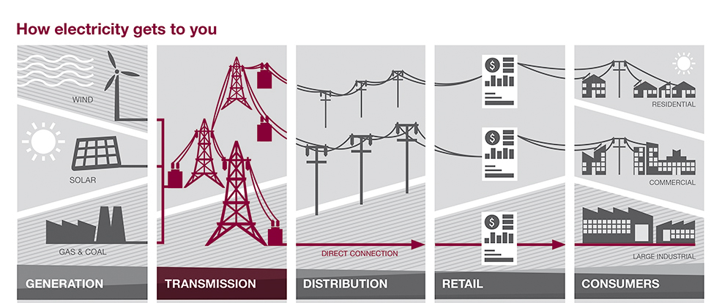
What is ElectraNet’s role?
ElectraNet
Our transmission network safely moves electricity across South Australia. It is made up of:
  over 5,600 circuit kilometres of 275 kV, 132 kV and 66 kV transmission lines
  approximately 30kms of underground 275 kV cable
  89 High-Voltage substations

Slide 5
What do consumers value?
Safe, secure and dependable operation of the network to support a reliable supply of electricity
Affordability
Choice
Reliability
Keeping prices low and sustainable by focussing on lowest long-run cost outcomes
Innovating and transforming the network to meet the demands of new technology and changing needs of customers and consumers

Slide 6
What’s changing?
Electricity industry is undergoing fundamental changes and the pace of change is increasing
Current state of play:
Electricity demand – flat in aggregate
Electricity prices – easing
Gas prices – rising but not as much as predicted by some
Solar PV – steady growth
Climate policy – investment under RET increasingly challenging
Tariff reform – early stages
Renewable energy integration – SA is a world leader relative to demand

Slide 7
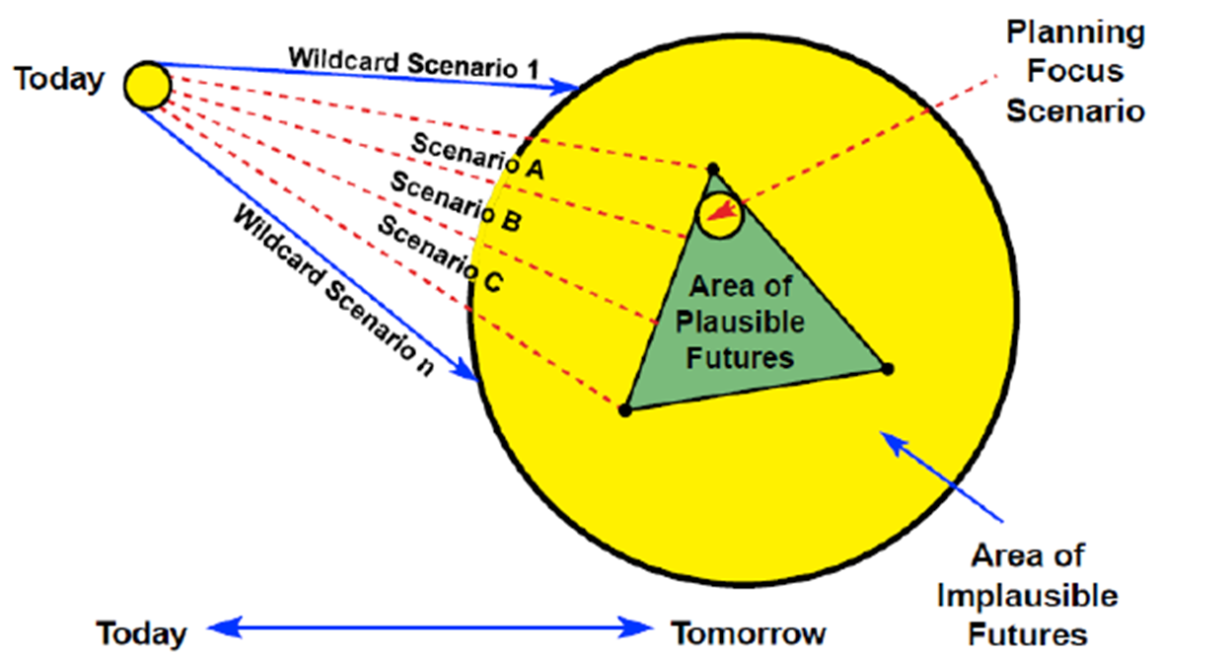
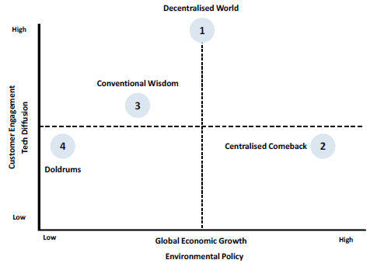
What might the future look like?
INTERNAL Distribution: Board and Management

Slide 8
Emerging Directions and Priorities
Uptake of distributed energy resources changing role of grid
Ongoing role for transmission
Changing generation mix
New grid technologies

Slide 9
Emerging Directions and Priorities (1)
Theme 1: The network will continue to play an important role
EMERGING DIRECTIONS | PROPOSED PRIORITIES
Grid maximum demand remains steady Grid supplied energy remains flat or declining The existing grid needs to be maintained efficiently and safely Maximum demand driven investment is expected to be minimal Network utilisation will continue to fall, placing ongoing pressure on unit costs The age and condition of the network will be an increasing challenge to manage | Focus on efficiently prolonging asset life wherever possible and deferring major replacement Continue to maintain the existing network as safely and efficiently as possible through reliability centred maintenance Retire assets unlikely to be needed in the future where economic to do so Consider options to recover past and future investment in the most timely manner to protect future consumers Explore more efficient pricing arrangements to promote clarity, stability and fairness Manage any major mining triggered developments as contingent projects within the regulatory framework

Slide 10
Emerging Directions and Priorities (2)
Theme 2: The uptake of distributed energy by consumers is changing the role of the grid
EMERGING DIRECTIONS | PROPOSED PRIORITIES
Further significant installation of rooftop solar PV capacity is expected, with periods of zero grid level demand expected within a decade The impact of energy storage at a consumer level is likely to have limited impact on the grid over the planning horizon The uptake of electric vehicles by consumers is expected to be modest Distributed energy growth rates are uncertain and will be driven by consumer preferences, technology costs and policy support Forecasting technology uptake is therefore challenging and scenario planning is important to consider a range of possible futures | Actively monitor trends and developments to ensure the grid is ready to integrate distributed energy technology Plan for emerging technologies in order to maintain safe, reliable and secure supply under foreseeable operating conditions

Slide 11
Emerging Directions and Priorities (3)
Theme 3: The generation mix is changing, creating new challenges for operation of the grid
EMERGING DIRECTIONS | PROPOSED PRIORITIES
The withdrawal of conventional generators is placing greater reliance on wind generators and interconnectors The operation of the network is becoming more complex and challenging The potential consequences of State-wide outages after rare interconnector separation events is increasing | Pursue efficient options to address more complex network operation with less conventional generation Investigate further interconnector upgrade opportunities where in the consumer interest (with any major investments to be pursued as contingent projects)

Slide 12
Emerging Directions and Priorities (4)
Theme 4: New technologies are changing the way network services are delivered
EMERGING DIRECTIONS | PROPOSED PRIORITIES
Storage technology is likely to become economic in the medium term at a grid scale, offering a new potential option to efficiently deliver network and ancillary services In a flat demand environment, non-network solutions and new technologies such as storage can offer more economic alternatives to traditional network options Ongoing advances in information technology and network control systems provides access to a wealth of ‘big data’ to inform network decision making | Continue to investigate application of grid scale storage where economic and seek to gain experience in the deployment and operation of this emerging technology Actively pursue demand side solutions and other innovations in the deployment of non-network solutions and new technology Develop analytical capability to manage ‘big data’ to improve decision making in asset management and network operation

Slide 13
Table Discussions

Slide 14
1. What is the future role of the transmission network?
Modelling, analysis and feedback to date indicates a strong ongoing role for the transmission network to:
  Deliver a safe, reliable and affordable power to large industrial customers and the distribution network
  Enable a competitive market by transporting electricity across interconnected regions and allowing the cheapest energy to be used to meet consumers needs
  Support continued connection and integration of wholesale renewable generation to help reduce SA’s greenhouse footprint
  Provide backup, start up power, balancing and power quality services and enable ongoing growth in distributed energy resources
Q1: What do you see as the future role of South Australia’s transmission network to deliver on consumers’ expectations?

Slide 15
2. What are the priorities to deliver on this?
Key priorities proposed to deliver on the future role of the network include:
  Maintain the existing network as safely and efficiently as possible
  Efficiently prolong asset life wherever possible, and retire assets where needed
  Explore options for more timely recovery of past and future investment
  Explore more efficient pricing arrangements to promote clarity, stability & fairness
  Ensure the grid is ready to integrate distributed energy technologies
  Pursue efficient options to address more complex network operation with less conventional generation
  Investigate further interconnector upgrade opportunities where economic
  Pursue grid scale storage, demand-side options, other innovative solutions and new technology, and develop capability to manage ‘big data’
Q2: To what extent do you agree with these priorities? Which are most important? Is there anything missing?

Slide 16
3. What are we missing?
Q3: Are there any other issues we should be considering or taking into account?

Slide 17
Thank you
Rainer Korte
08 8404 7983
0417 686 224
Korte.Rainer@electranet.com.au

